Slide 1
DATA LITERACY
Data Analytics Bootcamp

Slide 2




Meet your Trainer
NAME
MAIMOONA KHILJI
EDUCATION
MS DATA SCIENCE (2025-27)
BS DATA SCIENCE (2019-23)
from the Institute of Management Sciences
EXPERIENCE
DATA SCIENTIST
| Atomcamp
Visiting Faculty
| Institute of Management Sciences
ACHIEVEMENTS
DISTINCTION HOLDER + MICROSOFT-CERTIFIED
Straight A+ student, speaker and panellist in various tech forums, recipient of multiple merit-based scholarships.

Slide 3
QUESTIONS TO THINK ABOUT
What is Data?
Why we need data?
How can we achieve data-driven decision-making?
What skills can help?

Slide 4
What is data?
A collection of facts, figures and statistics collected and stored for reference and analysis.

Slide 5

Problem Solving
Informed Decision-Making
Predictive Analysis
Why We Need Data?
Draw valuable insights
Reduce future Risk

Slide 6
Qualitative vs Quantitative Data
QUANTITATIVE
QUALITATIVE
numeric values that can be quantified
non-numeric & descriptive
CONTINUOUS
DISCRETE
NOMINAL
ORDINAL
Infinite values within a range​
e.g., height, weight
Finite values within a range​
e.g., ​ shoe size, ​
Labels or
categories​
e.g., ​ blood type, gender
Ranked categories​
e.g., ​ grades A-F, satisfaction rating

Slide 7
Data Literacy Skills
NON-TECHNICAL
Communication
Domain Knowledge
Research
Critical Thinking
TECHNICAL
Analysis
Visualization
Management
Mathematics
Programming Languages

Slide 8
Statistical Foundations
Statistical foundations provide the basic principles and methods for collecting, analyzing, interpreting, and presenting data.
Key Concepts:
Population and Sample: Population is the entire group you want to draw conclusions about, while a sample is a subset of the population.
Variables: Characteristics or properties that can take on different values (e.g., age, income, temperature).
Scales of Measurement: Nominal, ordinal, interval, and ratio scales used to classify data.

Slide 9
Descriptive Statistics
Descriptive statistics summarize and describe the main features of a dataset.
Key Measures:
Central Tendency: Mean (average), median (middle value), and mode (most frequent value).
Dispersion: Range (difference between highest and lowest values), variance (measure of variability), and standard deviation (average amount by which values differ from the mean).
Visualization: Using charts and graphs like histograms, bar charts, and box plots to visualize data distribution and patterns.

Slide 10
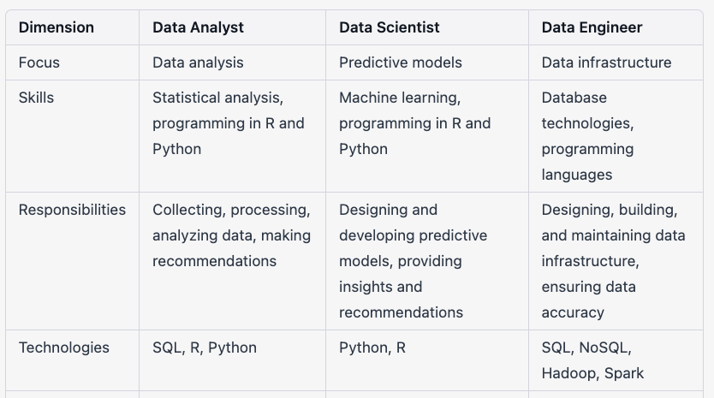

Slide 11
DATA ANALYSIS
Inspecting, cleaning, transforming, and modeling data to discover useful information, draw conclusions, and support decision-making.

Slide 12
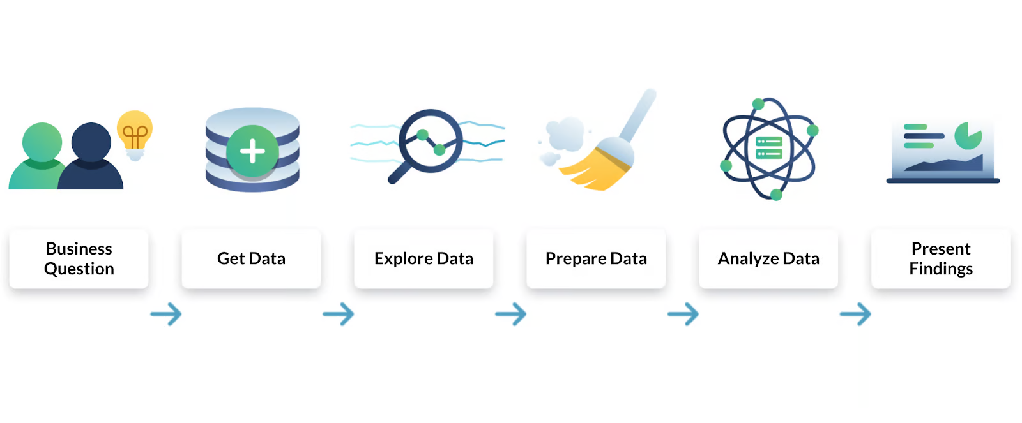
Data Analysis Process

Slide 13
EDA
Explore the data to understand the data structure(columns and values)
List down anomalies
Missing values
Duplicates
Text inconsistency (Yes or Y, )
Outliers
Data types (15 years => remove “years” from age columns)
Deal or Handle the Anomalies (Data preprocessing, cleaning, cleansing, preparation)
Analysis

Slide 14
Data Analysis Steps
Data Collection
Understand the data
List down the anomalies
Deal with anomalies
Analysis
Visualization / report to present insights or key findings

Slide 15
Types of Data Analytics
DESCRIPTIVE
DIAGNOSTIC
PREDICTIVE
PRESCRIPTIVE
What happened?
Summarizing and presenting data in a meaningful way (e.g., mean, median, mode).
Why did it happen?
Identifying patterns & relationships in the data to understand the "why" behind certain trends.
What will happen?
Building models to make predictions based on historical data.
How can we make it happen?
Recommending actions based on analysis to achieve specific outcomes.

Slide 16
Descriptive analysis
Summer revenue is higher than Winter
Summer collection is higher in volume
Diagnostic
Relation between products and sales
Higher summer collection leads to higher sales in summer
Predictive analysis
If I increase the winter collection or add more variety, what will happen?
Winter sales will increase
Prescriptive analysis (recommendation or suggestions)
Add more winter collection to your store

Slide 17
Thank You

